Slide 1
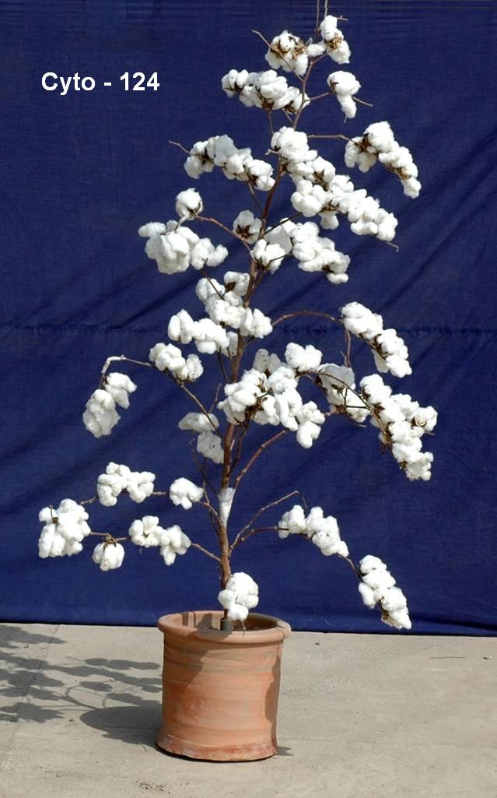
Non Bt.
CYTO-124
Highly CLCuV Tolerant Interspecific
Variety
Yield (kg ha⁻¹) | GOT (%) | Staple Length (mm) | Micronaire (µg/inch) | Maturity
3000-3500 | 42.8 | 30.3 | 4.3 | 92.4

Slide 2
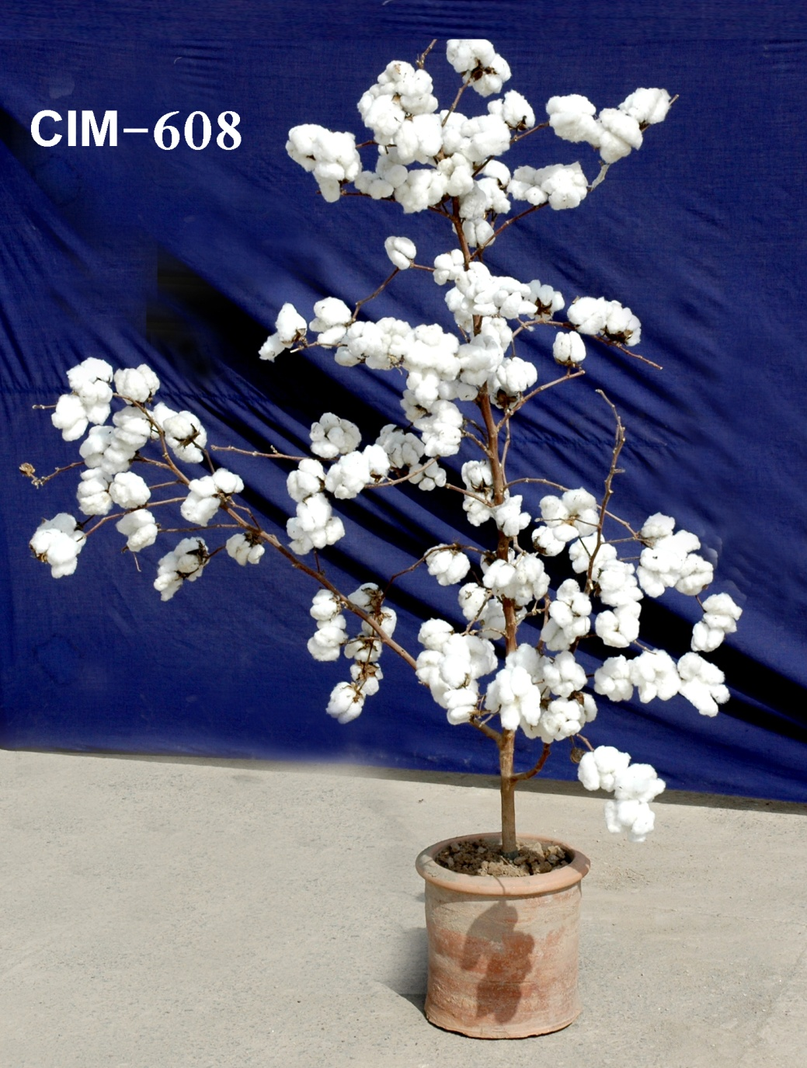
Non Bt.
CIM - 608
1st Interspecific
Variety
Yield (kg ha⁻¹) | GOT (%) | Staple Length (mm) | Micronaire (µg/inch) | Maturity
3000-3500 | 40.3 | 30.0 | 4.7 | 95.4

Slide 3
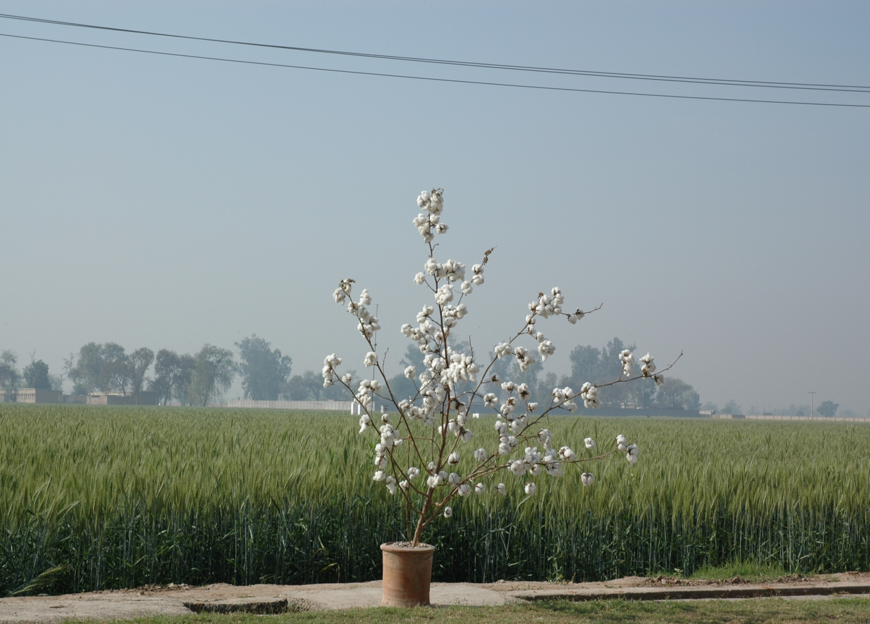
Bt. CYTO - 177
High yielding, drought & heat tolerant Variety
Yield (kg ha⁻¹) | GOT (%) | Staple Length (mm) | Micronaire (µg/inch) | U.I (%)
4175 | 40.0 | 28.99 | 4.3 | 83.7

Slide 4
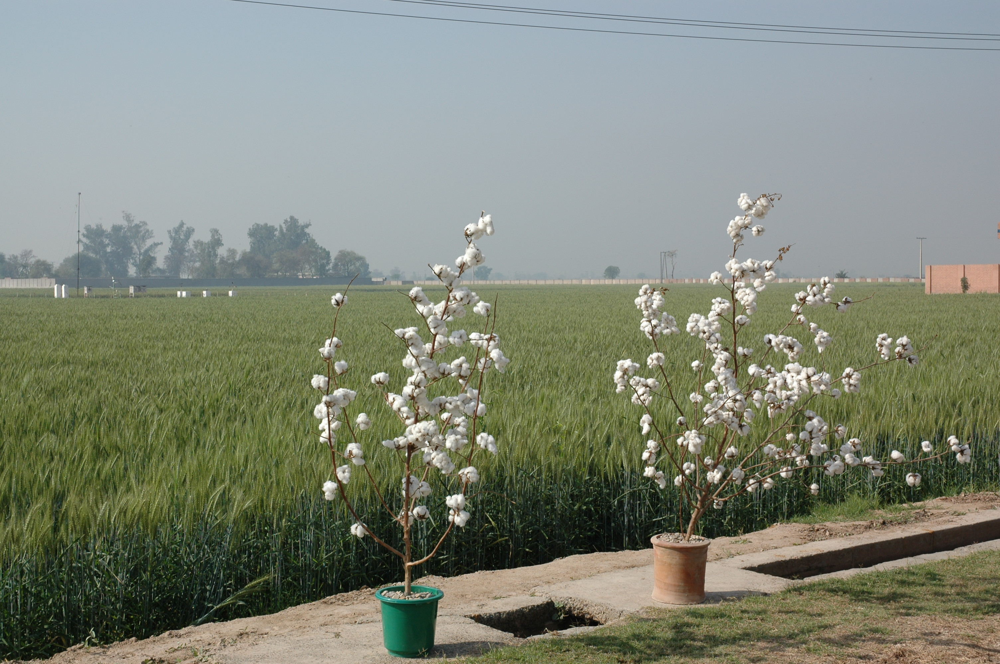
Bt. CYTO – 178
High yielding &Virus tolerant Variety
Yield (kg ha⁻¹) | GOT (%) | Staple Length (mm) | Micronaire (µg/inch) | Fibre Strength (tppsi)
4500 | 39.5 | 28.1 | 4.5 | 105.5

Slide 5
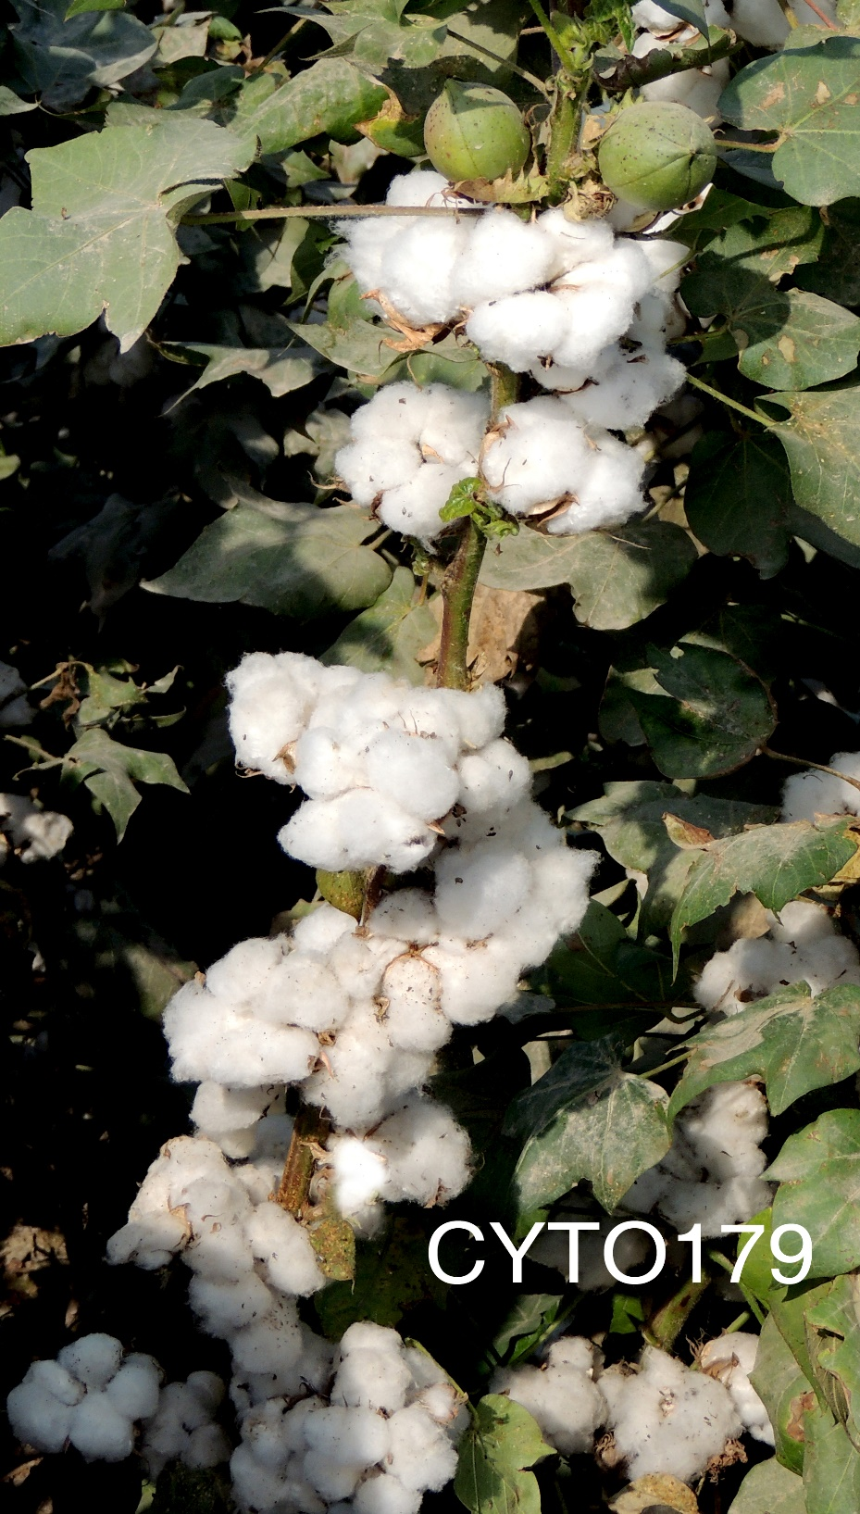
Bt. Cyto-179
High yielding & drought tolerant Variety
Yield (kg ha⁻¹) | Lint (%age) | Fibre length (mm) | Fibre Fineness (µg inch⁻¹) | Fibre Strength (tppsi)
5077 | 40.2 | 28.2 | 4.2 | 107.6

